Slide 1
Sprint 2 Delivery WAtch2Gether Clone

Slide 2
Sprint Goals
Define techstack
Walking Skeleton

Slide 3

Sprint 2 Achievements

Slide 4
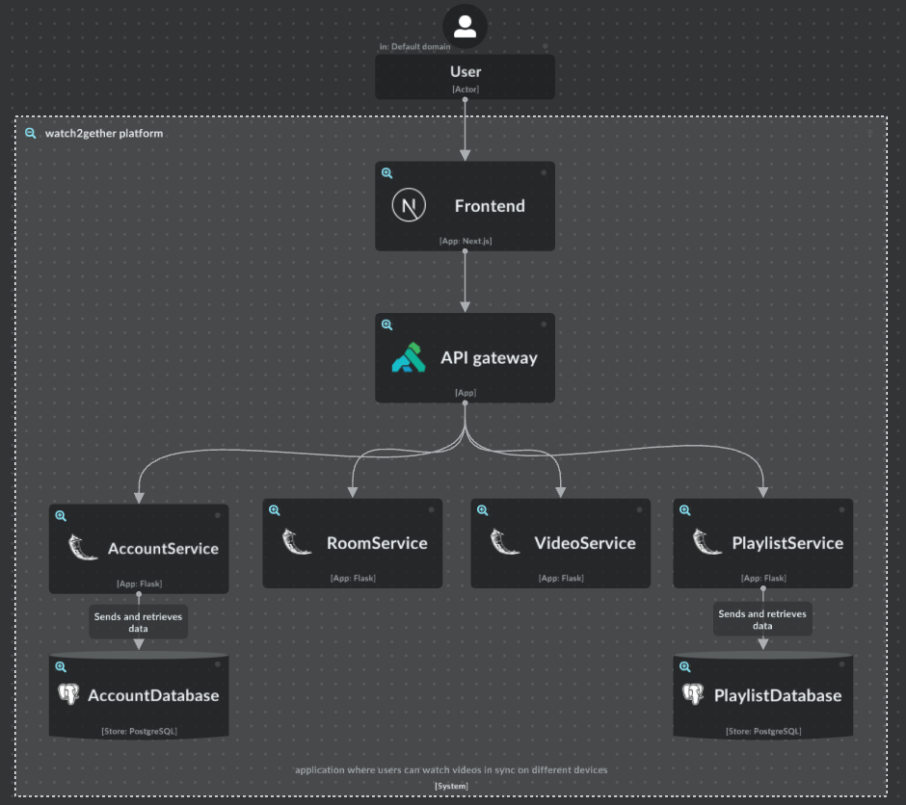
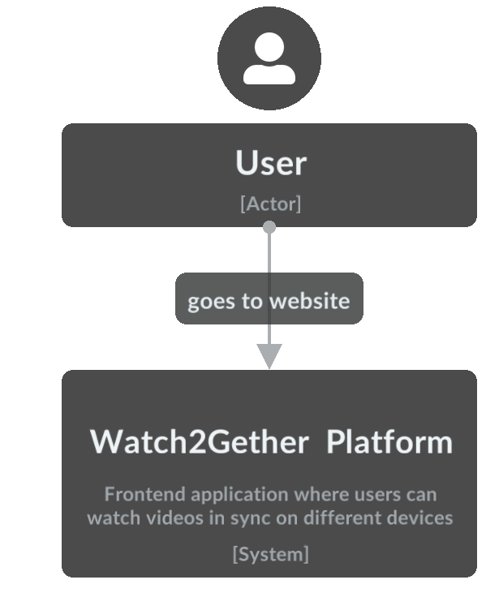
C1 & C2 Diagram

Slide 5
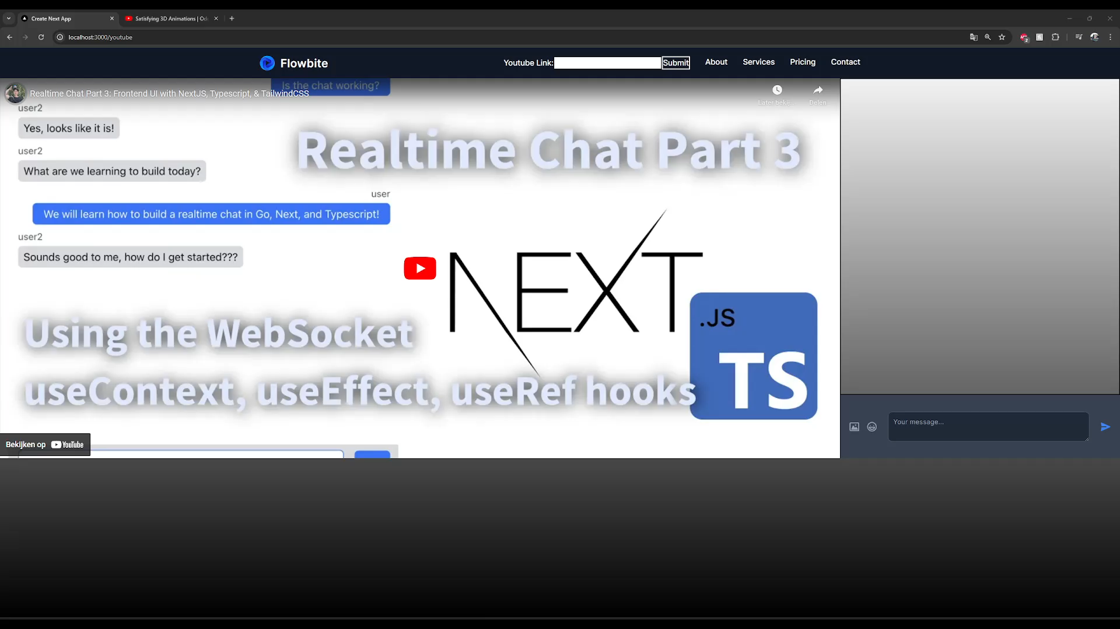

Slide 6
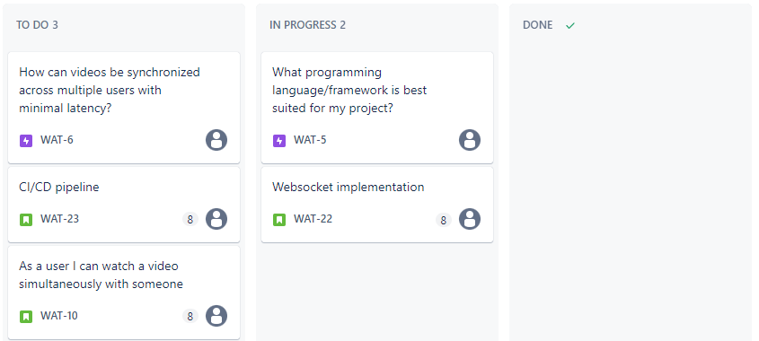
Sprint Planning

Slide 7

Thank you
Any Questions?

